Slide 1

Chat Analyzer
WHATSAPP
Presenter
Name = Om, Piyush

Slide 2
Topics cover :-
Introduction
Timeline
Primary goals
Conclusion
REFERENCE
Presentation Title

Slide 3

Introduction
We propose a tool for analyzing WhatsApp Chats in this paper. A WhatsApp conversation contains different types of messages exchanged among group and individual users. These technologies provide the right learning experience. An analysis is provided by this application for data extracted from WhatsApp chats. Seaborn, streamlit, numpy, matplotlib, and Pandas are just a few of the Python libraries that can be used to implement this system, which is an advantage of this application. The most common purpose of these is to create data frames and graphs after data preprocessing.

Slide 4
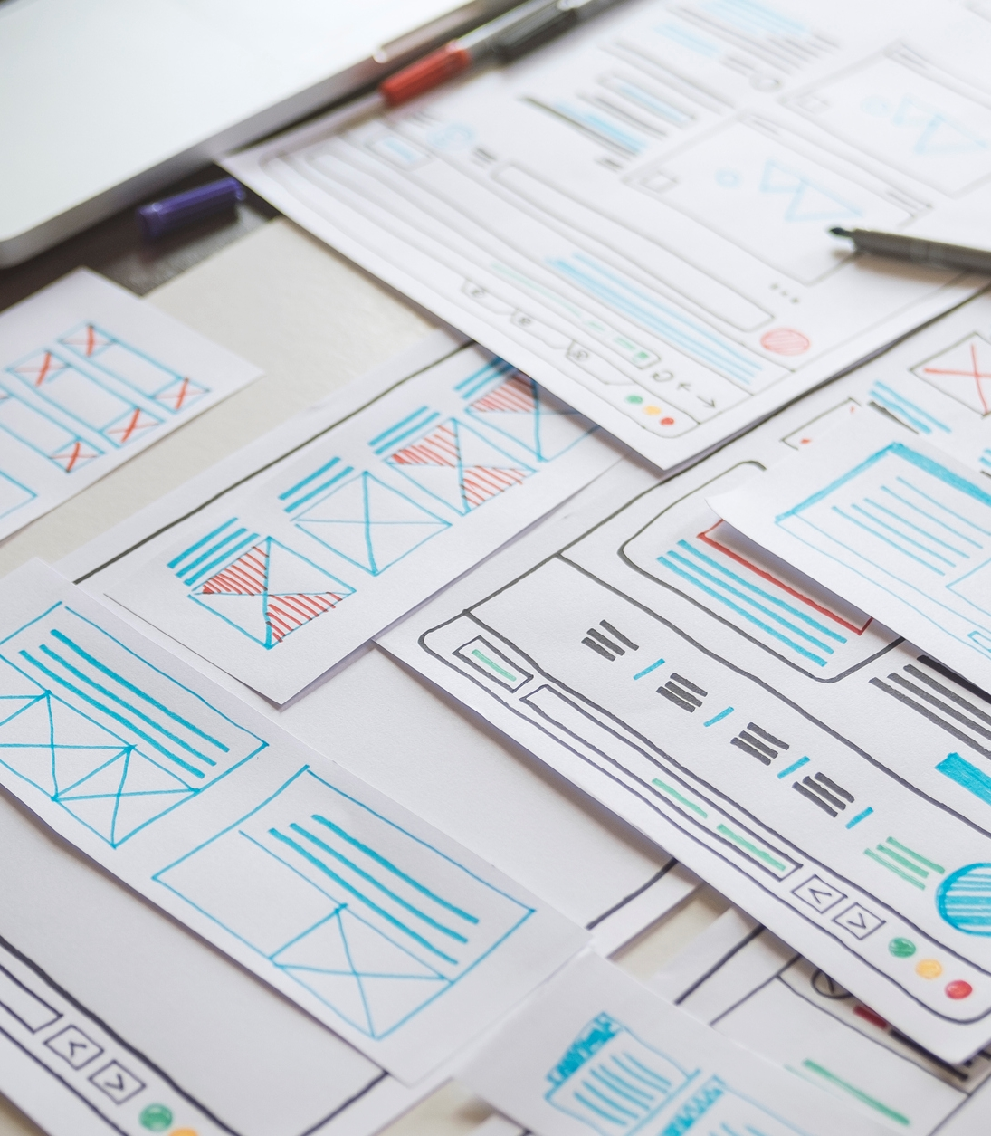

Popularity: WhatsApp is extremely popular in India, with a large user base across different age groups and demographics. It is often the preferred messaging platform for personal and professional communication. Messaging: WhatsApp is primarily used for sending text messages, voice messages, images, videos, and documents Group Chats: Group chats are a prominent feature of WhatsApp, allowing users to create groups with family members, friends, classmates, or colleagues to communicate and share updates collectively. Business Use: In addition to personal use, WhatsApp is increasingly being adopted by businesses in India for customer support, marketing, and sales.
ANNUAL
USE OF
CHAT’S

Slide 5
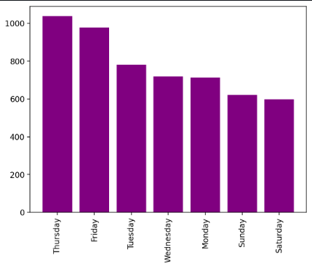
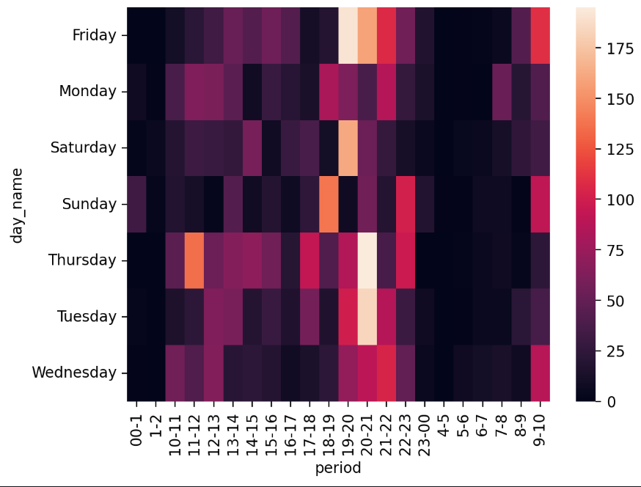
Live Example of group chat on daily or weekly bases

Slide 6
Primary Goal
The primary goal of a chart analyzer is to interpret and analyze data presented in various types of charts, such as bar charts, line charts, pie charts, etc. Its purpose is to extract meaningful insights from the visual representation of data and communicate those insights effectively to aid decision-making processes. Chart analyzers typically focus on identifying trends, patterns, anomalies, correlations, and other relevant information within the data depicted in the chart. By understanding the information conveyed by the chart, users can make informed decisions in fields such as business, finance, economics, science, and many others.

Slide 7


Conclusion
The WhatsApp application, combined with the Python programming language and its powerful data analysis capabilities, is an unbeatable combination. We successfully achieved the desired outcomes. Our project is useful for organizers who can now identify the most and least active members of their group and make decisions accordingly. The initial objective of the project, as defined during the requirement analysis phase, has been successfully achieved. The system is user-friendly, with a simple menu, making it easy for even those with limited knowledge of computers to operate the system. Additionally, the system avoids the drawbacks of the existing manual system, and its validation facility eliminates the possibility of wrong data entry.

Slide 8


Teammates
Om
Piyush
Operation Officer
Project Handler

Slide 9



References
1. K Ravishankara, V Dhanush, IS Srajan .International Journal of Engineering Research & Technology, 2020
2. Shaikh Mohd Saqib, Prof. Sujata Bhosle .International Research Journal of Modernization in Engineering Technology and Science ,2022
3. Alan Jones (2021,Nov 28). Build a Personal Webpage with Streamlit {https://medium.com/codefile/build-a-promotional-webpage-with-streamlit-4088b87354d2}
4. Raj Guleria (Jan 16). How to plot a graph in Python — Python Tutorial {https://medium.com/@rajguleria3/how-to-plot-a-graph-in-python-python-tutorial-1847400b02 c6}
5. Yash_R. Seaborn Heatmap – A comprehensive guide {https://www.geeksforgeeks.org/seaborn-heatmap-a-comprehensive-guide}

Slide 10




Thank you
Om
Piyush
Om.cse@gmail.com
Piyush.cse@gmail.com

